Slide 1





IN PRESCHOOL EDUCATİON LEARNİNG
JOURNEY WITH ARTIFICAL INTELLIGENCE

Slide 2








Erasmus+
KA210-SCH-7C6CE7E9

Slide 3

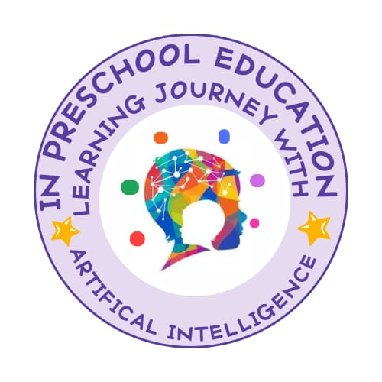

What is Artificial Intelligence in Education?
Artificial intelligence in education is the technology used to improve learning processes, personalize teaching methods and increase educational efficiency.

Slide 4


Our Goals
Ensuring the effective use of artificial intelligence technologies in preschool education.
Integrating innovative approaches to mathematics-science, language, music and game activities.
Developing students' creativity, problem-solving and digital skills.
Creating intercultural cooperation in education with the partnership of Germany, Turkey, Italy and Romania.

Slide 5

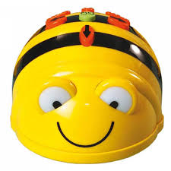
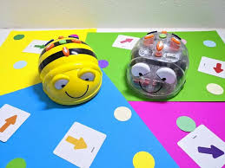
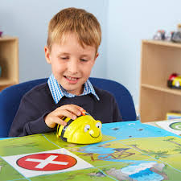
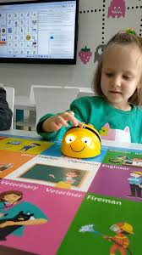
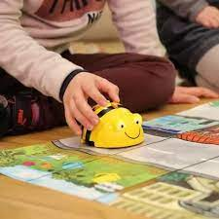
Coding based games with Beebot

Slide 6
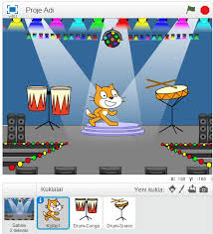

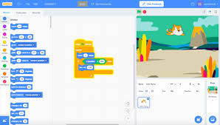
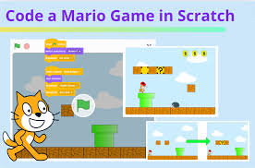
Coding games with Scratch

Slide 7


Music Events
Creating notes on fruits with Makey Makey and making different sound experiences.
Activities introducing cultural music of partner countries.

Slide 8
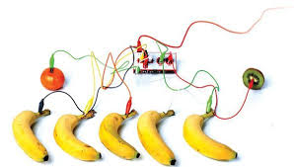
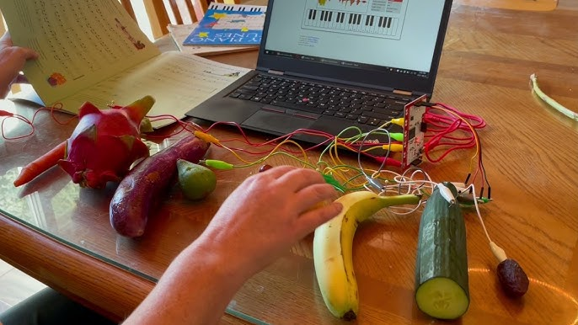
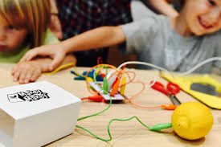
Create notes from fruits and create different sound experiences with Makey Makey.

Slide 9


Game Activities
Turning students' drawings into games with Draw Your Game.
Bringing their own drawings to life with Animated Drawings.

Slide 10


International Cooperation and Results
Sharing of knowledge among teachers.
Enriched learning materials for students.
Evaluation of implementation results in different countries.

